Slide 1
Ovarian cancer cytogenomics
Aakila Sammy

Slide 2
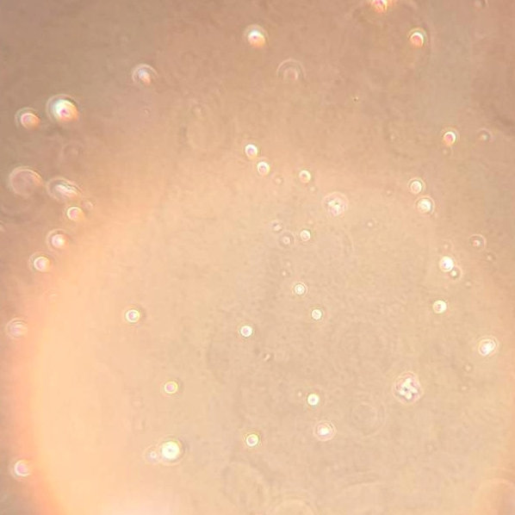
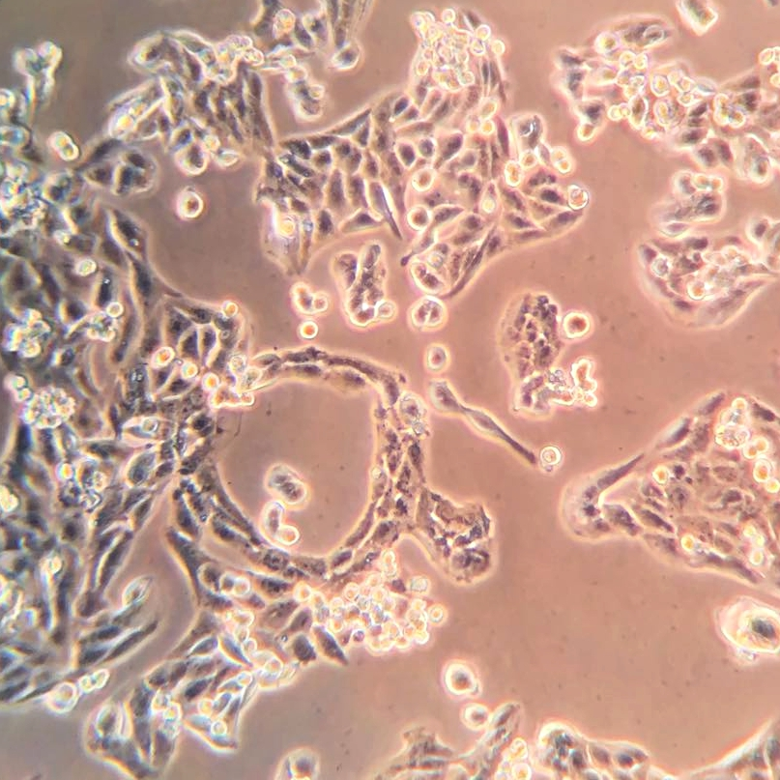
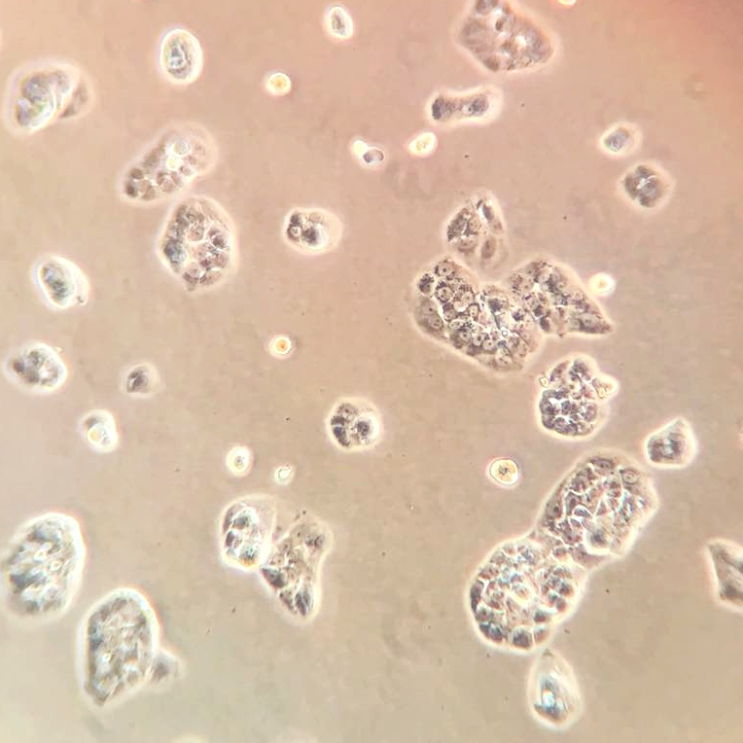
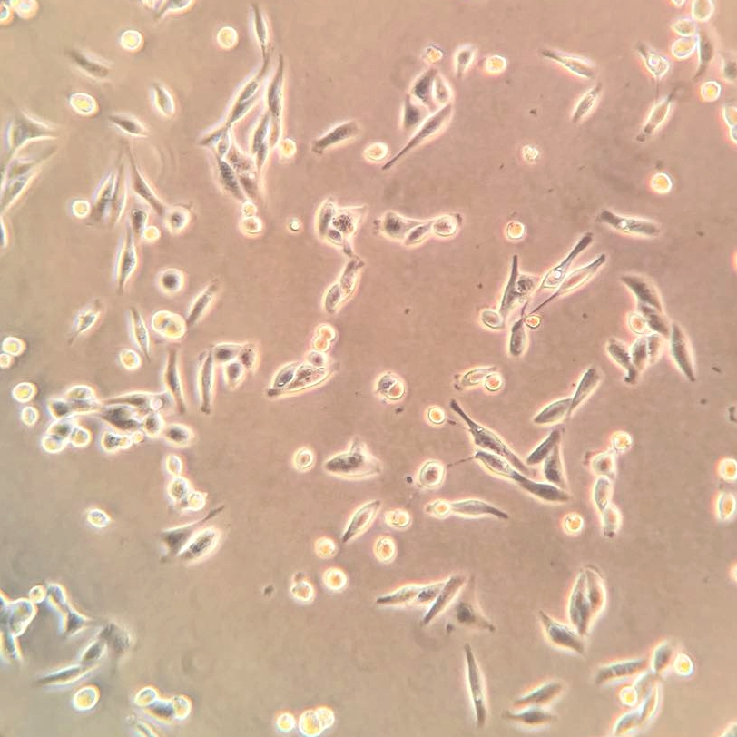
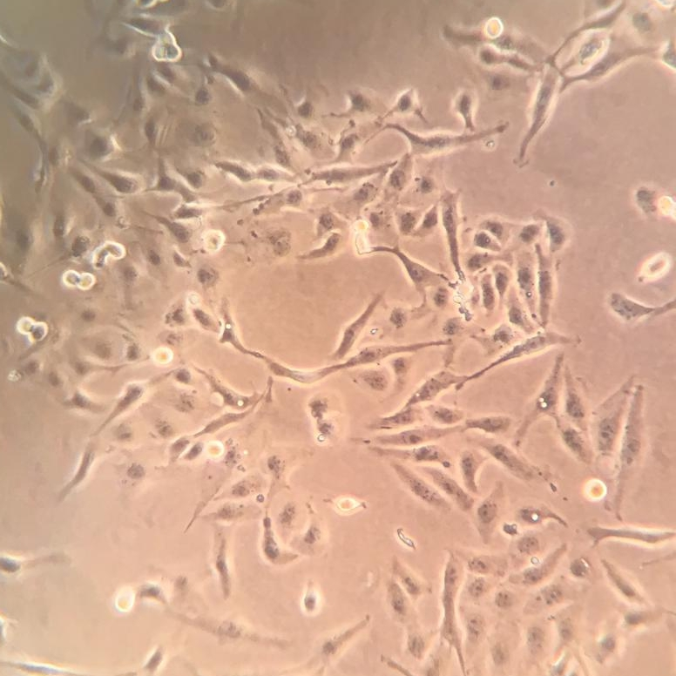
Challenges associated with Ovarian Cancer
Late diagnosis
Drug toxicity – TAXOLS
Drug resistance - PLATINS
hOSEpic
MDAH-2774
PEO-4
SKOV-3
PEO-1
Notes:
Symptoms are mistaken for everyday body changes and by the time it is noticed its already at an advanced stage. Drug treatment at these stages are effective, however when it comes to first line treatment for this and other cancers the drugs are either too toxic to the individual or develops resistance (common with late stage cancers)

Slide 3
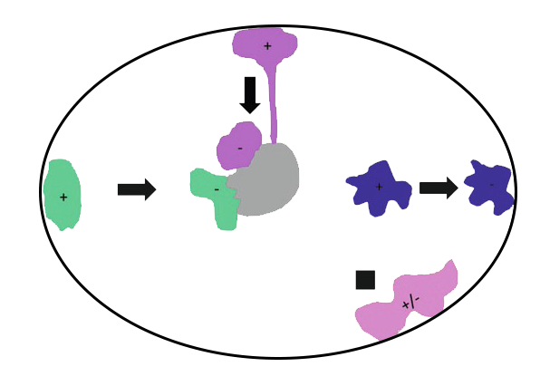
Chromosomes move
Non-randomly organized & Re-organise
Physiological conditions – Serum Level
Cell Cycle – Senescence
In diseases – HGPS, colon, cervical, leukemia and many more.
13
10
18
Depiction of Nuclear position of whole chromosome territories before (+) and after (-) serum removal in Primary human dermal fibroblast nucleus
-Dr Joanna Bridger
X

Slide 4
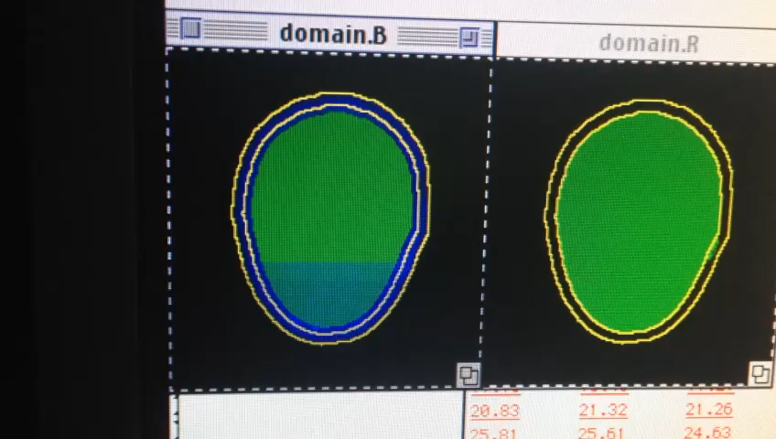
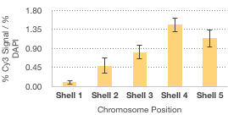
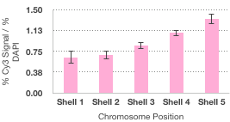
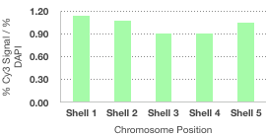
FISH
FISH – Fixation, Hybridisation, Washing, Visualisation and Analyse
Sample longevity
FISH kits by Abbot Molecular
Biomarker panel
Prognostic potential
X
10
13

Slide 5
Drug Resistance
Chromosomes move – faster or permanent response
Treat cells with cisplatin
Check genome territory periodically
Pinpoint permanent or temporary changes
Stop this adaptation with RNAi (temporary quick changes)
Crosslinks with DNA, Damaged DNA to point of Apoptosis
MDAH-2774 treated with 25uM Cisplatin 48hrs
PEO-1 treated with 20uM Cisplatin 48hrs
Notes:
RNAi – temporarily during treatment only
Cells unable to develop resistance and requires lower drug dosage to be effective
Use in combination with chemotherapeutics investigating lower doses

Slide 6
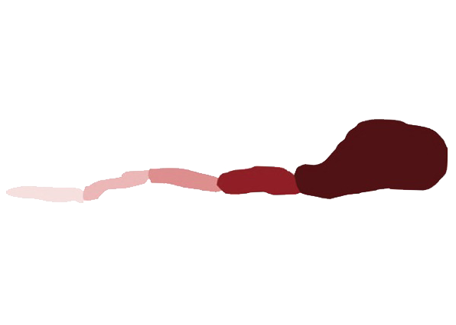
Nuclear Myosin
Motor inhibition – GTPase and ATPase
Acto-myosin polymersisation
Suppression of expression
Investigate nuclear myosins role in ovarian cancer cytogenomics
Nuclear position of whole chromosome territories before (+) and after (-) serum removal
13
Head- nucleotide and actin binding site
TH3 - signal transduction, actin dynamics and membrane trafficking
18
10
Neck
Nucleolus
TH1 – Phospholipid and membrane binding
X
TH2
– actin
binding
Primary human dermal fibroblast nucleus

Slide 7
Drug Toxicity
Exploit RNAi to weaken cell, without myosin it acquires a senescent characteristic
Decrease the dosage requirement
Paclitaxel and drug toxicity
Cytoskeletal drug stabilizing microtubule polymerization, preventing disassembly

Slide 8
References
Bridger, JM. and Volpi, EV. (2010) ‘Fluorescence in situ Hybridization (FISH): Protocols and Applications’. Methods in Molecular Biology, vol. 659
Bridger, JM., Arican-Gotkas, HD., Foster, HA., Godwin, LS., Harvey, A., Kill, IR., et al. (2014) ‘The Non-random Repositioning of Whole Chromosomes and Individual Gene Loci in Interphase Nuclei and Its Relevance in Disease, Infection, Aging, and Cancer’. Advances in Experimental Medicine and Biology, 773. pp. 263 – 279
Nuclear Molecular Motors for Active, Directed Chromatin Movement in Interphase Nuclei, Joanna M. Bridger and Ishita S. Mehta
Meaburn, KJ. (2016) ‘Spatial Genome Organization and Its Emerging Role as a Potential Diagnosis Tool’. Frontiers in Genetics, 7:134
Penner-Goeke, S., Lichtensztejn, Z., Neufeld, M., Ali, JL., Altman, AD., Nachtigal, MW., et al. (2017) The temporal dynamics of chromosome instability in ovarian cancer cell lines and primary patient samples. PLoS Genet 13:4
https://www.molecular.abbott/int/en/products/oncology/vysis-alk-break-apart-fish-probe-kit
https://www.molecular.abbott/int/en/products/oncology/urovysion-bladder-cancer-kit

Slide 9

Conclusion
Diagnosing ovarian cancer earlier while combatting drug resistance and toxicity through cytogenomics
www.aakilasammy.co.uk
Notes:
Insert QR code

